Slide 2
INDEX
Section A: | Revision of <, >, ≤ and ≥ symbols.
Section B: | Revision of Number Systems
Section C: | Number Systems and the Number Line.
Section D: | Solving inequalities of the form $ax + b <k.$
Section E: | Multiplying and Dividing an inequality by a Negative Number.
Section G: | Solving inequalities graphically.
Section H: | To investigate the rules of inequalities.
Section I: | Double Inequalities .

Slide 3
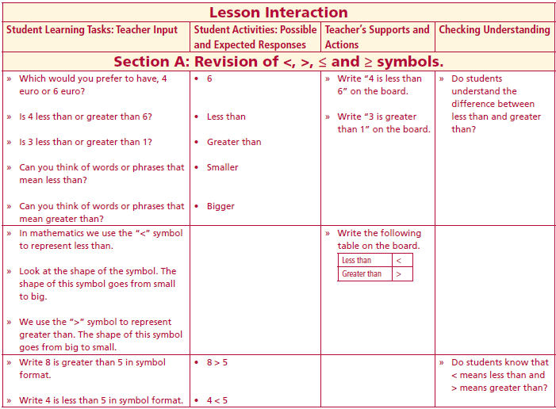
Section A: Student Activity 1 Revision of <, >, ≤ and ≥ symbols.
Which would you prefer to have, 4 euro or 6 euro?
Is 4 less than or greater than 6?
Is 3 less than or greater than 1?
Can you think of words or phrases that mean less than?
Can you think of words or phrases that mean greater than?
In mathematics we use the “<” symbol to represent less than.
Look at the shape of the symbol. The shape of this symbol goes from small to big.
We use the “>” symbol to represent greater than. The shape of this symbol goes from big to small.
Write 8 is greater than 5 in symbol format.
Write 4 is less than 5 in symbol format.
Lesson interaction

Slide 4
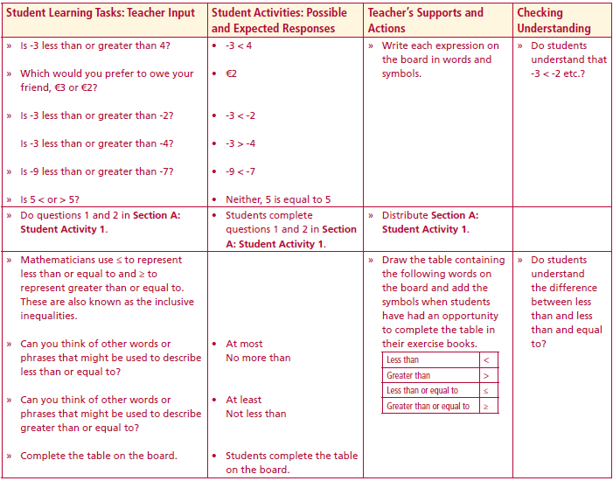
Section A: Student Activity 1 Revision of <, >, ≤ and ≥ symbols.
Is -3 less than or greater than 4?
Which would you prefer to owe your friend, €3 or €2?
Is -3 less than or greater than -2?
Is -3 less than or greater than -4?
Is -9 less than or greater than -7?
Is 5 < or > 5?
Do questions 1 and 2 in Section A: Student Activity 1.
Lesson interaction

Slide 5
Section A: Student Activity 1 Revision of <, >, ≤ and ≥ symbols.
1. The table below contains a number of inequalities. In the space provided,
indicate which are true and which are false
Inequality | True/False |  | Inequality | True/False
$2<$3 |  |  | $$4≤5$$
$$−1>4$$ |  |  | $$1>−4$$
$$−2>−1$$ |  |  | $$3>4$$
$$−1≤4$$ |  |  | $$−1≥4$$
$$1.2<4$$ |  |  | $$−1.8>4$$
$$\frac{1}{2}<\frac{3}{4}$$ |  |  | $$\frac{1}{2}>\frac{1}{4}$$
$$−\frac{1}{2}<\frac{3}{4}$$ |  |  | $$\frac{1}{2}>−\frac{3}{4}$$

Slide 6
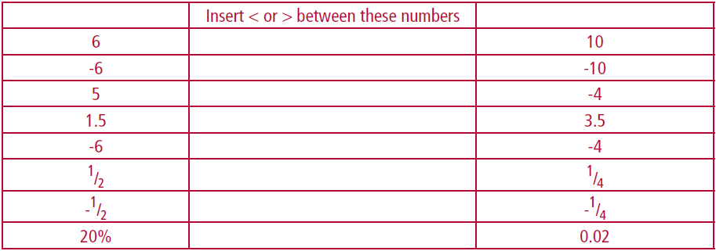
Section A: Student Activity 1 Revision of <, >, ≤ and ≥ symbols.
2. Insert the appropriate symbol between these numbers.

Slide 7
Section A: Student Activity 1 Revision of <, >, ≤ and ≥ symbols.
Mathematicians use ≤ to represent less than or equal to and ≥ to represent greater than or equal to. These are also known as the inclusive inequalities.
Can you think of other words or phrases that might be used to describe less than or equal to?
Can you think of other words or phrases that might be used to describe greater than or equal to?
Complete the table.
Lesson interaction
 | Symbol
Less Than
Greater than
Less than or equal to
More than or equal to

Slide 8
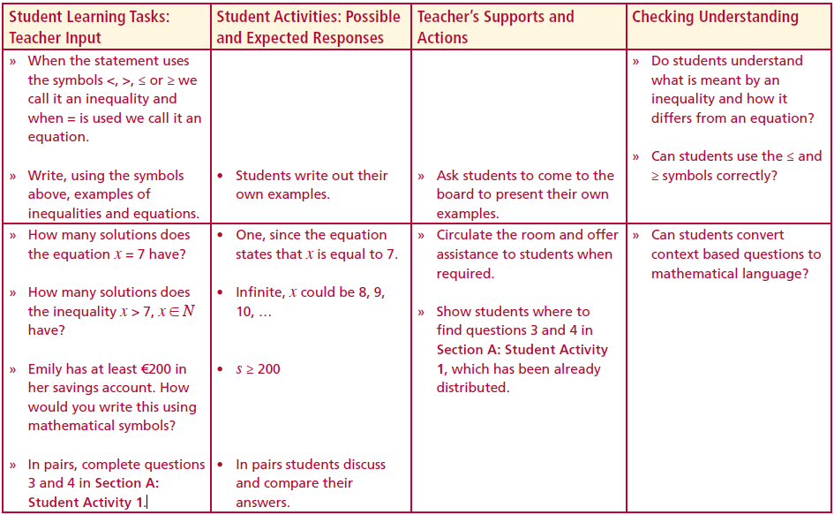
Section A: Student Activity 1 Revision of <, >, ≤ and ≥ symbols.
When the statement uses the symbols <, >, ≤ or ≥ we call it an inequality and when = is used we call it an equation.
Write, using the symbols above, examples of inequalities and equations.
How many solutions does the equation x = 7 have?
How many solutions does the inequality x > 7, x ∈ N have?
Emily has at least €200 in her savings account. How would you write this using mathematical symbols?
In pairs, complete questions 3 and 4 in Section A: Student Activity 1.
Lesson interaction

Slide 9
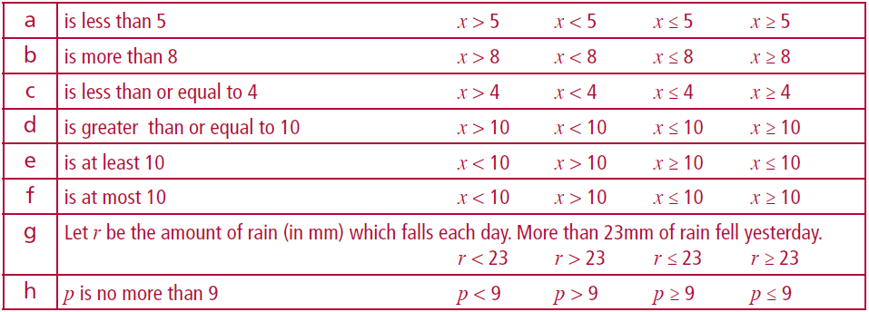
Section A: Student Activity 1 Revision of <, >, ≤ and ≥ symbols.
3. In each case, below, circle the algebraic expression which represents the statement given.

Slide 10
Section A: Student Activity 1 Revision of <, >, ≤ and ≥ symbols.
4. For each of the statements below, circle the inequality which represents the given statement.
a | The speed limit on a certain road is 60 km. Does this mean each driver has to drive at this speed or less? s= speed in km/h. Represent the speed limit using the variable s.
 | s < 60 s ≤ 60 s > 60 s ≥ 60
b | In order to be able to go on a school trip Kelly needs to have saved €40 or more. Kelly has saved €d and is not yet able to go on the trip. Which of the following is true?
 | d ≤ 40 d ≥ 40 d > 40 d < 40
c | To enter a particular art competition you must be at least 12 years old. Tom is n years old and he can enter the competition. Which of the following is true?
 | n < 12 n ≤ 12 n ≥ 12 n > 12
d | To enter an art competition you must be over 12 years old. Tom is n years old and he can enter the competition. Which of the following is true?
 | n < 12 n ≤ 12 n ≥ 12 n > 12

Slide 11
Section A: Student Activity 1 Revision of <, >, ≤ and ≥ symbols.
4. For each of the statements below, circle the inequality which represents the given statement.
e | The maximum number of people allowed in a cinema is 130. If there are b people in the cinema. Which of the following is true?
 | b > 130 b ≥ 130 b ≤ 130 b < 130
f | The best paid workers in a business earn €40 per hour. Mark earns €m per hour and he is not one of the best paid employees in the business. Which of the following is true?
 | m ≥ 40 m < 40 m > 40 m ≤ 40
g | Emma’s mother says that when she reaches the age of 17 she will get an increase in her pocket money. Emma is r years old and has not yet received that increase. which of the following is true?
 | r < 17 r > 17 r ≤ 17 r ≥ 17
h | There are at least 200 animals in a zoo. If there are h animals in the zoo, which of the following is true?
 | h > 200 h < 200 h ≥ 200 h ≤2 00

Slide 12
Section A: Student Activity 1
I | At most 10 people can fit in a bus and there are k people in the bus. Which of the following is true?
 | k < 10 k > 10 k ≤ 10 k ≥ 10
J | A film is given an age 18 certificate. Let a = age of a student. To watch the film which statement is true?
 | a < 18 a > 18 a ≤ 18 a ≥ 18
K | In Ireland you have to be at least 18 years old in order to be able to vote. Conor is w years old and he can vote, Which of the following is true?
 | w ≤ 18 w < 18 w > 18 w ≥ 18
l | In order to get to the next stage of the competition a team must have at least 20 points. Given x = the number of points scored by a team and they qualify for the next stage of the competition, which of the following is true?
 | x < 20 x ≤ 20 x > 20 x ≥ 20
m | The temperature in Dublin on a particular day is 20°C and it is warmer in Cork on the same day. Given x°C is the temperature in Cork, which of the following is true?
 | x ≤ 20 x < 20 x > 20 x ≥ 20

Slide 13
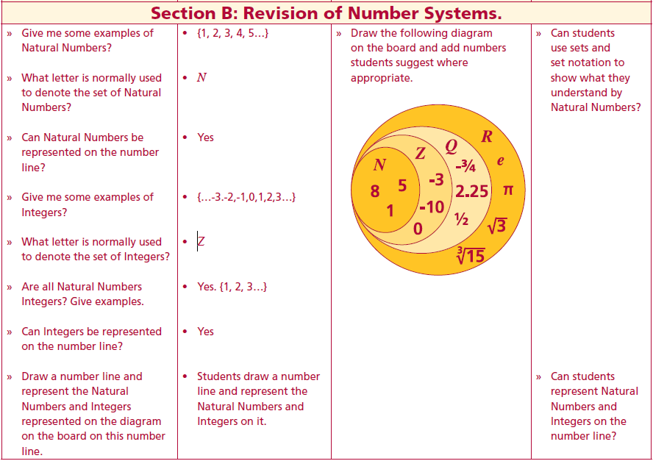
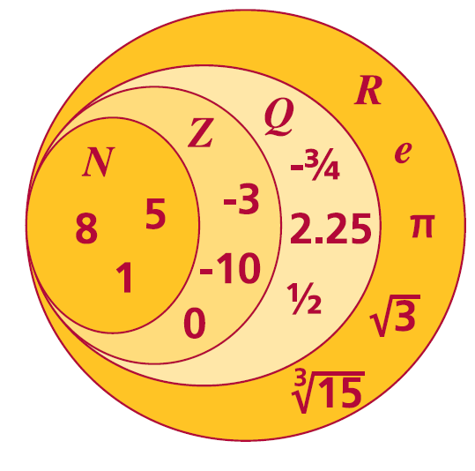
Section B: Student Activity 1 Revision of Number Systems.
Give me some examples of Natural Numbers?
What letter is normally used to denote the set of Natural Numbers?
Can Natural Numbers be represented on the number line?
Give me some examples of Integers?
What letter is normally used to denote the set of Integers?
Are all Natural Numbers Integers? Give examples.
Can Integers be represented on the number line?
Draw a number line and represent the Natural Numbers and Integers represented on the diagram on the board on this number line.
Lesson interaction

Slide 14
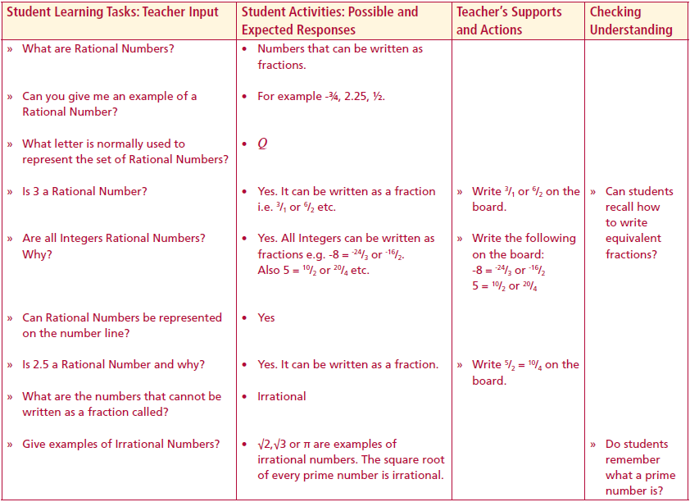
Section B: Student Activity 1 Revision of Number Systems.
What are Rational Numbers?
Can you give me an example of a Rational Number?
What letter is normally used to represent the set of Rational Numbers?
Is 3 a Rational Number?
Are all Integers Rational Numbers?
Why?
Can Rational Numbers be represented on the number line?
Is 2.5 a Rational Number and why?
What are the numbers that cannot be written as a fraction called?
Give examples of Irrational Numbers?
Lesson interaction

Slide 15
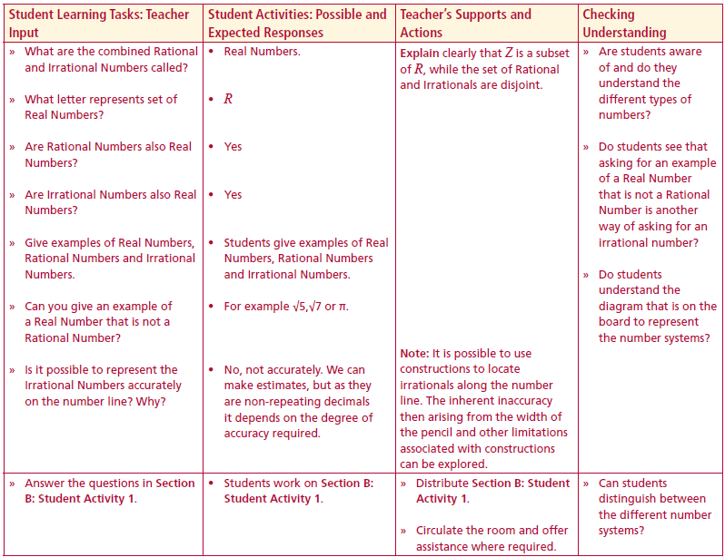
Section B: Student Activity 1 Revision of Number Systems.
What are the combined Rational and Irrational Numbers called?
What letter represents set of Real Numbers?
Are Rational Numbers also Real Numbers?
Are Irrational Numbers also Real Numbers?
Give examples of Real Numbers, Rational Numbers and Irrational Numbers.
Can you give an example of a Real Number that is not a Rational Number?
Is it possible to represent the Irrational Numbers accurately on the number line? Why?
Answer the questions in Section B: Student Activity 1.
Lesson interaction

Slide 16
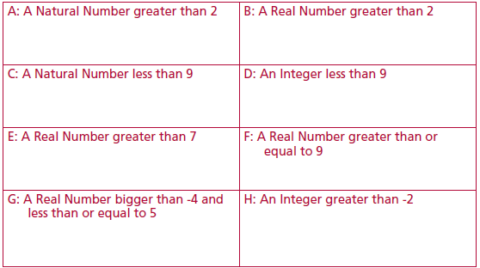
Section B: Student Activity 1 Revision of Number Systems.
1. Write the relevant numbers from below into each of the boxes A, B, C, E, F, G and H. Note: Numbers may be used more than once.
-3, 0∙5, 6, 8, 10, -4, 20, -5, 3½, -6∙2, 1, 11, 2, 3, 9, 5, 5∙2, -2, 7∙9, 12, 11∙3.

Slide 17
Section B: Student Activity 1 Revision of Number Systems.
Write down one number which you included in box B, but did not include in box A. Give a reason for your choice.___________________________
x > 5, x ∈ N means: (Note: There may be more than one correct answer.)
(i) a number less than 5 is a possible solution
(ii) 5 is a possible solution
(iii) 6 is a possible solution
(iv) 5 is the only solution
(v) natural numbers should be Natural Numbers
(vi) Every natural number greater than 5 represents a general solution
4. x > 5, x ∈ N means: (Note: There may be more than one correct answer.)
(i) a number less than 4 is possible solution
(ii) 8 is a possible solution
(iii) 6 is a possible solution
(iv) 5 is the only solution
5. What is the general solution to the inequality in Q4?

Slide 18
Section B: Student Activity 1 Revision of Number Systems.
6. x ≤ 6, x ∈ N State giving a reason which of the following are true or false.
i. 6 is a possible solution_________________________________________
ii. 7∙8 is a possible solution_______________________________________
iii. -4 is a possible solution_______________________________________
iv. 9 is a possible solution________________________________________
v. The solution set contains 6 elements
7. Given x ≤ 9, x ∈ Z, write “True” or “False” beside each of the following.
i. 6 is a possible solution_________________________________________
ii. 10∙8 is a possible solution______________________________________
iii. -4 is a possible solution_______________________________________
iv. 9 is a possible solution________________________________________
8. Given x < 8, x ∈ Z, write “True” or “False” beside each of the following.
i. x is less than or equal to 8______________________________________
ii. x is greater than 8____________________________________________
iii. x is less than 8_______________________________________________
iv. x is 8 ______________________________________________________
v. x can be a fraction____________________________________________

Slide 19
Section B: Student Activity 1 Revision of Number Systems.
9. Write the sentence: “x is a Natural Number less than 4.”, in algebraic form (using symbols).
10. Write the sentence: “x is a Natural Number greater than 3.”, in algebraic form.
11. Write the sentence: “y is a Rational Number greater than or equal to 12.”, in algebraic form.
12. Write the sentence: “p is an Integer less than 7.”, in algebraic form.
13. Which of the statements below represents the pattern
14, 15, 16, 17, 18, 19, ...
(a) x < 14, x ∈ Z (b) x > 14, x ∈ R (c) x ≤ 14, x ∈ R
(d) x ≥ 14, x ∈ N (e) x > 14, x ∈ N
14. Which of the statements below represents the set A? A={-10,-9,-8,-7,-6,-5,…}
(a) x < -10, x ∈ Z (b) x ≥ -10, x ∈ Z (c) x ≤-10, x ∈ R (d) x > -10, x ∈ Z (e) x ≥ -10, x ∈ R.

Slide 20
Section C: Student Activity 1 Number Systems and the Number Line.
Where along the number line on the above does the set of Natural Number begin?
Does it include 1?
Which direction is the arrow pointing?
As the arrow is on a continuous line, what set of numbers do you think is being represented on the following number line.
If instead of a closed circle at 1 we had an open circle, how do you think the inequality would differ?
Note: When solving inequalities it is very important that the number system to which the number belongs is stressed.
Lesson interaction

Slide 21
Section C: Student Activity 1 Number Systems and the Number Line.
What does each of the diagrams on the board represent?
$$x ≥ 4, x ∈ N$$
$x > 1, x ∈ R$
$x ≤ 1, x ∈ R$
$x < 1, x ∈ R$
Lesson interaction

Slide 22
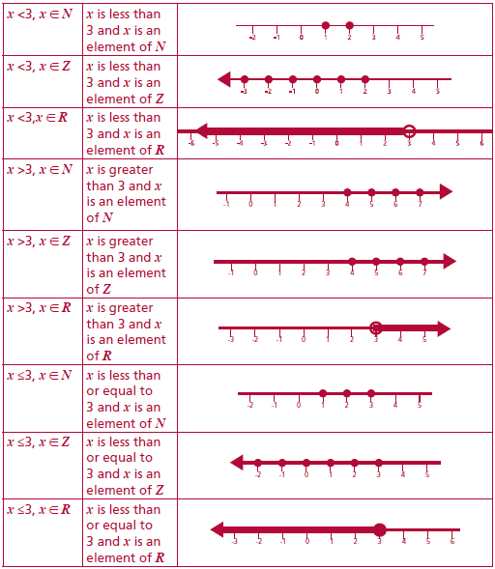
Section C: Student Activity 1 Number Systems and the Number Line.
A class set of the following should be laminated and cut up prior to the beginning of the lesson

Slide 23
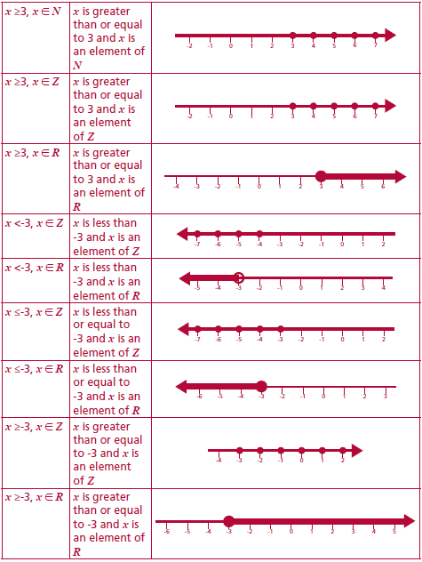
Section C: Student Activity 1 Number Systems and the Number Line.
A class set of the following should be laminated and cut up prior to the beginning of the lesson

Slide 24
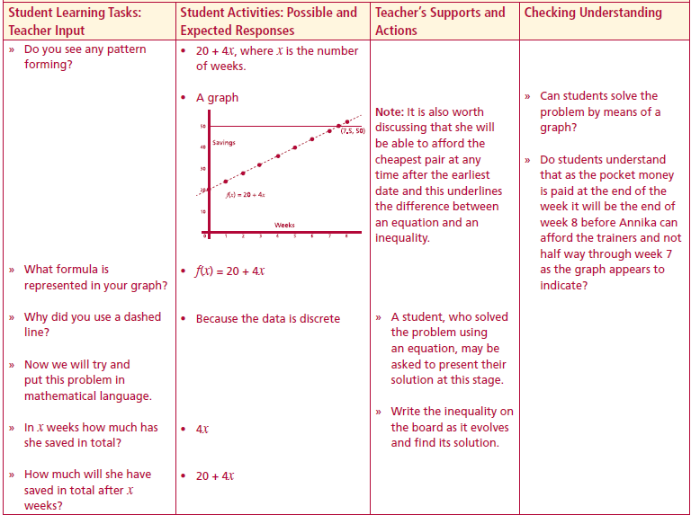
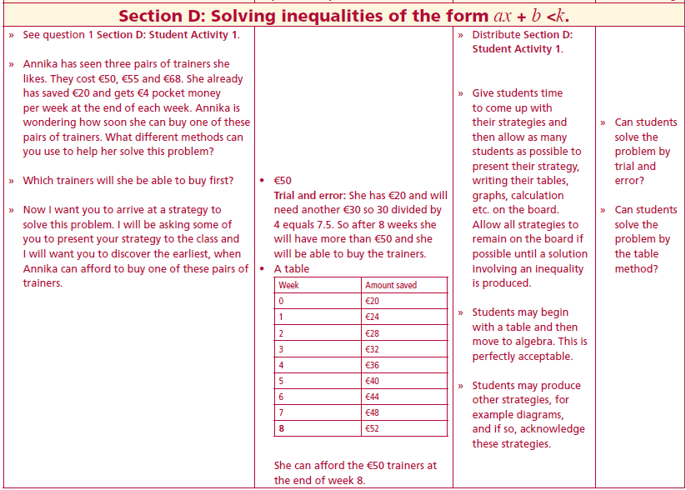
Section D: Student Activity 1 Solving inequalities of the form $ax + b <k.$
Annika has seen three pairs of trainers she likes. They cost €50, €55 and €68. She already has saved €20 and gets €4 pocket money per week at the end of each week. Annika is wondering how soon she can buy one of these pairs of trainers. What different methods can you use to help her solve this problem?
Which trainers will she be able to buy first?
I want you to arrive at a strategy to solve this problem. I will be asking some of you to present your strategy to the class and I will want you to discover the earliest, when Annika can afford to buy one of these pairs of trainers.
Lesson interaction
Lesson interaction

Slide 25
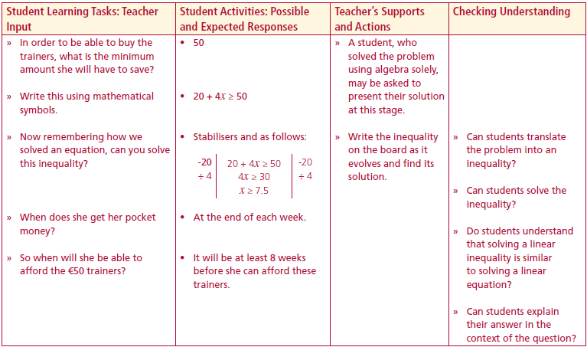
Section D: Student Activity 1 Solving inequalities of the form $ax + b <k.$
Annika has seen three pairs of trainers she likes. They cost €50, €55 and €68. She already has saved €20 and gets €4 pocket money per week at the end of each week. Annika is wondering how soon she can buy one of these pairs of trainers. What different methods can you use to help her solve this problem?
Now we will try and put this problem in mathematical language.
In $x$ weeks how much has she saved in total?
How much will she have saved in total after $x$weeks?
In order to be able to buy the trainers, what is the minimum amount she will have to save?
Write this using mathematical symbols.
Now remembering how we solved an equation, can you solve this inequality?
When does she get her pocket money?
So when will she be able to afford the €50 trainers?
Lesson interaction
Lesson interaction

Slide 26
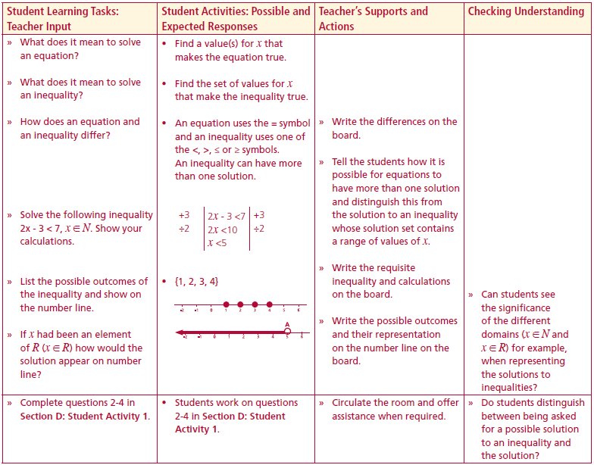
Section D: Student Activity 1 Solving inequalities of the form $ax + b <k.$
What does it mean to solve an equation?
What does it mean to solve an inequality?
How does an equation and an inequality differ?
Solve the following inequality $2x − 3 < 7, x ∈ N$. Show your calculations.
List the possible outcomes of the inequality and show on the number line.
If $x$ had been an element of $R (x ∈ R)$how would the solution appear on number line?
Complete questions 2-4 in Section D: Student Activity 1.
Lesson interaction
$$2x −3<7$$
$$+3$$
$$+3$$
$$2x<10$$
$$÷2$$
$$x<5$$
$$÷2$$

Slide 27
Section D: Student Activity 1 Solving inequalities of the form $ax + b <k.$
Annika has seen three pairs of trainers she likes. They cost €50, €55 and €68. She already has saved €20 and gets €4 pocket money per week at the end of each week. Annika is wondering how soon she can buy one of these pairs of trainers. What different methods can you use to help her solve this problem?
Which of the following is an element of the solution set of the inequality $4x + 5 > 29?$
i.4 ii. -5 iii. 6 iv. 7.
3. Solve the following inequalities for x ∈ R and represent their solutions on the number line:
i. $x + 3 <5$
ii. $x −6 <5$
iii. $2x + 3 <5$
iv. $2x + 3 <15$
v. $12x + 3≥ 111$

Slide 28
Section D: Student Activity 1 Solving inequalities of the form $ax + b <k.$
4. Complete the following two tasks for each of the problems below:
i. Solve the problem using a table, graph or trial and error. Show your calculations and explain your reasoning in all cases.
ii. Form an inequality to represent the problem and solve it algebraically.
a. Darren worked a six hour shift in his local restaurant and got €5 in tips. His total take home pay that evening was at least €69, find the minimum amount he was paid per hour.
b. A farmer wants to buy some cows and a tractor. The tractor costs €20,000 and the maximum he can spend is €60,000. Given that the average price of a cow is €900, find the maximum number of cows he can buy.
c. Ronan buys a tomato plant which is 5 centimetres in height. The tomato plant grows 3 centimetres every day. After how many days will the tomato plant reach the top of the glass house in which it is growing, given the glass house is 2 metres high.

Slide 29
Section D: Student Activity 1 Solving inequalities of the form $ax + b <k.$
4. Complete the following two tasks for each of the problems below:
i. Solve the problem using a table, graph or trial and error. Show your calculations and explain your reasoning in all cases.
ii. Form an inequality to represent the problem and solve it algebraically.
d. Declan is saving for a birthday present for his girlfriend and he already has €6. Given that he plans to spend at least €40 on the present and the birthday is five weeks hence, what is the least amount he should save per week?
e. A bridge across the river Geo can support a maximum weight of 20 tonnes. The company’s lorry weighs 8 tonnes and draws a trailer of 3 tonnes in weight. The company wants to find the maximum cargo they can take across this bridge using their lorry. Represent the problem, as an inequality and hence find the maximum weight of the cargo the lorry could carry cross the bridge

Slide 30
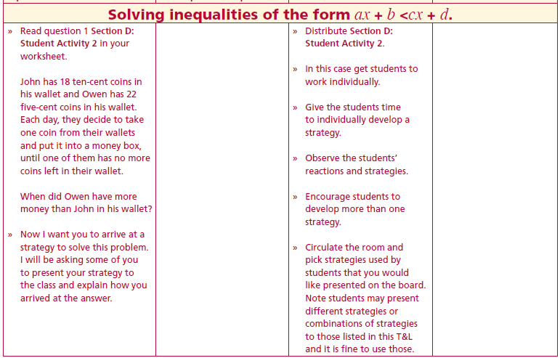
Section D: Student Activity 2 Solving inequalities of the form $ax + b < cx + d.$
John has 18 ten-cent coins in his wallet and Owen has 22 five-cent coins in his wallet. Each day, they decide to take one coin from their wallets and put it into a money box, until one of them has no more coins left in their wallet.
When does Owen have more money than John in his wallet?
Lesson interaction
John | Owen

Slide 31
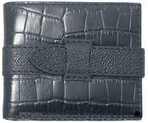
John has 18 ten-cent coins in his wallet and Owen has 22 five-cent coins in his wallet. Each day, they decide to take one coin from their wallets and put it into a money box, until one of them has no more coins left in their wallet.
When does Owen have more money than John in his wallet?
Lesson interaction
Day 1
Day 2
180c
Start
170c
160c
110c
100c
105c

Slide 33
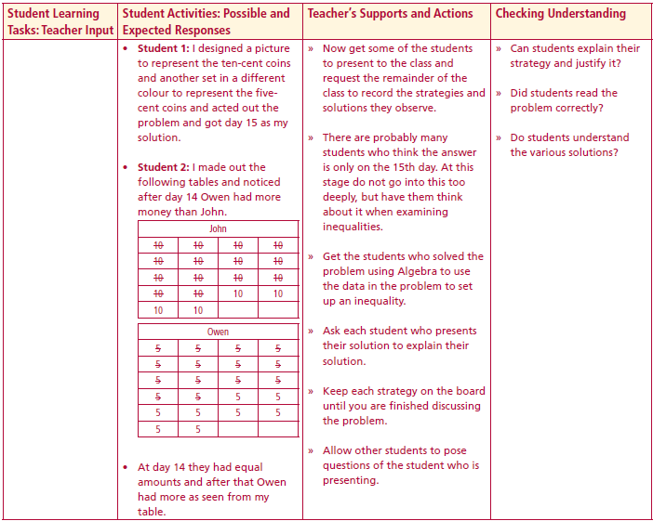
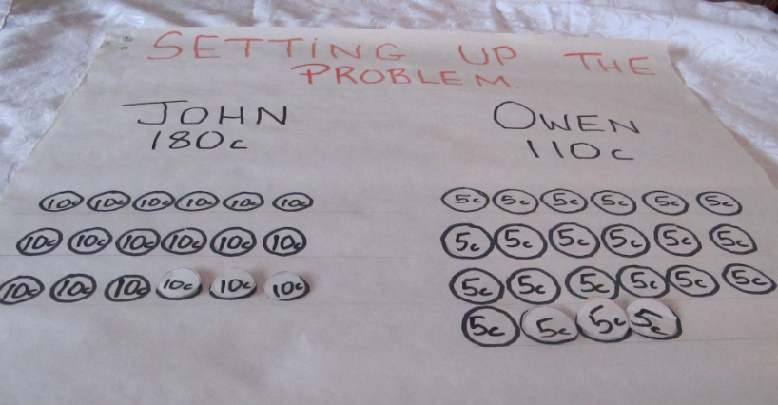
• Student 1: I designed a picture to represent the ten-cent coins and another set in a different colour to represent the five cent coins and acted out the
problem and got day 15 as my solution.
Lesson interaction
Solution 1

Slide 34
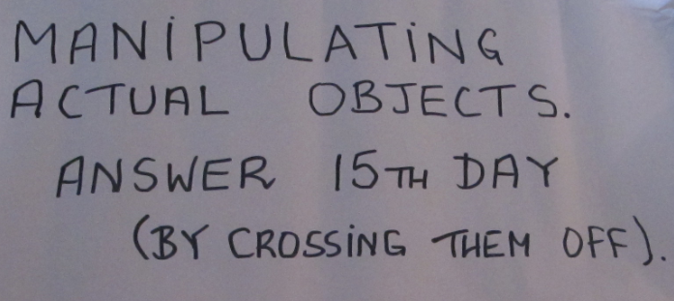

Slide 35
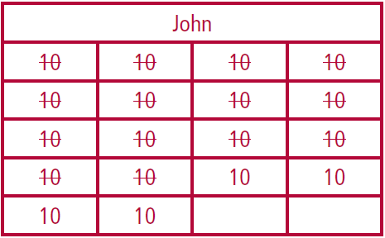
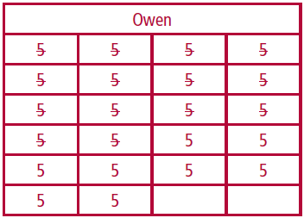
Student 2: I made out the following tables and noticed after day 14 Owen had more money than John.
At day 14 they had equal amounts and after that Owen had more as seen from my table.
Lesson interaction

Slide 36
Student 2: I made out the following tables and noticed after day 14 Owen had more money than John.
At day 14 they had equal amounts and after that Owen had more as seen from my table.
John
10 | 10 | 10 | 10
10 | 10 | 10 | 10
10 | 10 | 10 | 10
10 | 10 | 10 | 10
10 | 10
Owen
5 | 5 | 5 | 5
5 | 5 | 5 | 5
5 | 5 | 5 | 5
5 | 5 | 5 | 5
5 | 5 | 5 | 5
5 | 5
Lesson interaction
Solution 2

Slide 37
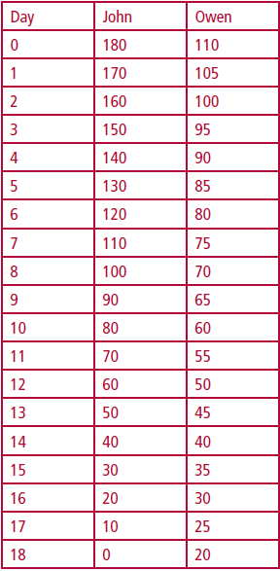
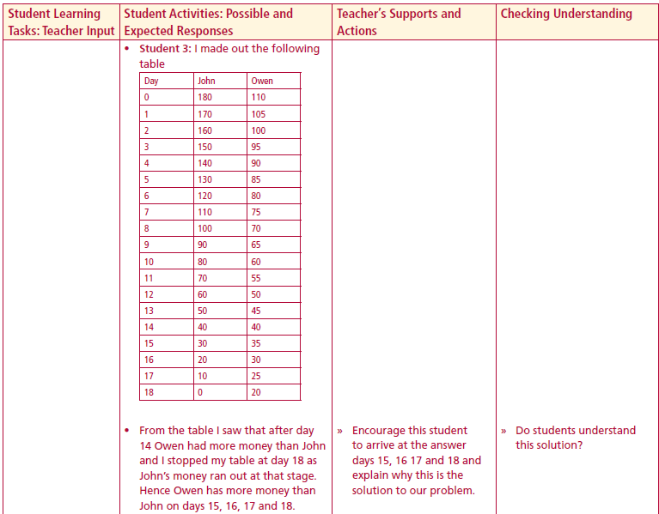
Student 3: I made out the following
Table
From the table I saw that after day 14
Owen had more money than John
and I stopped my table at day 18 as
John’s money ran out at that stage.
Hence Owen has more money than
John on days 15, 16, 17 and 18.
Lesson interaction
Solution 3

Slide 38
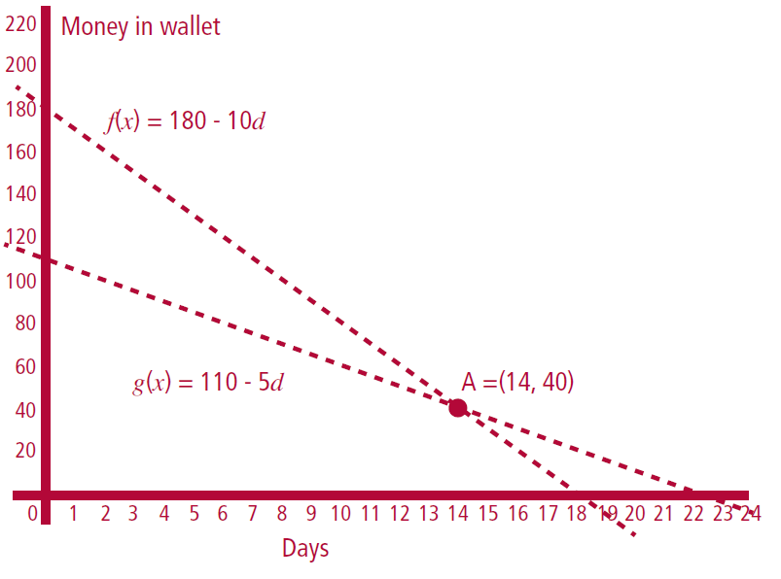
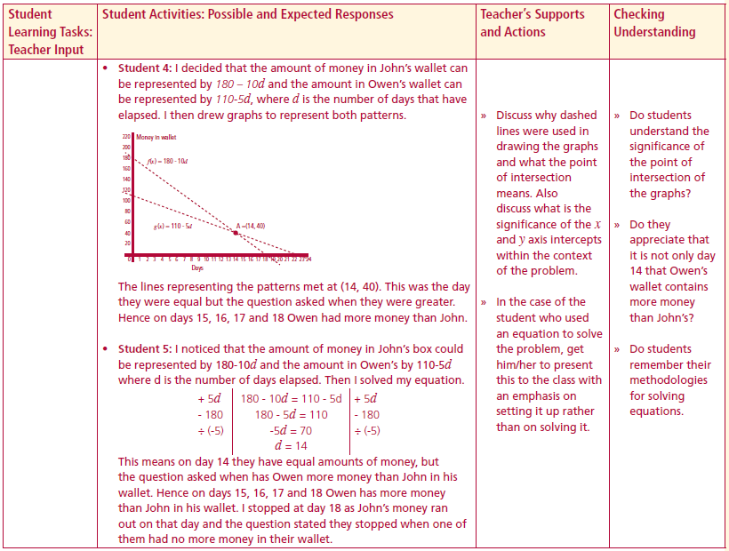
Student 4: I decided that the amount of money in John’s wallet can
be represented by 180 – 10d and the amount in Owen’s wallet can
be represented by 110-5d, where d is the number of days that have
elapsed. I then drew graphs to represent both patterns.
The lines representing the patterns met at (14, 40). This was the day
they were equal but the question asked when they were greater.
Hence on days 15, 16, 17 and 18 Owen had more money than John.
Lesson interaction
Solution 4

Slide 39
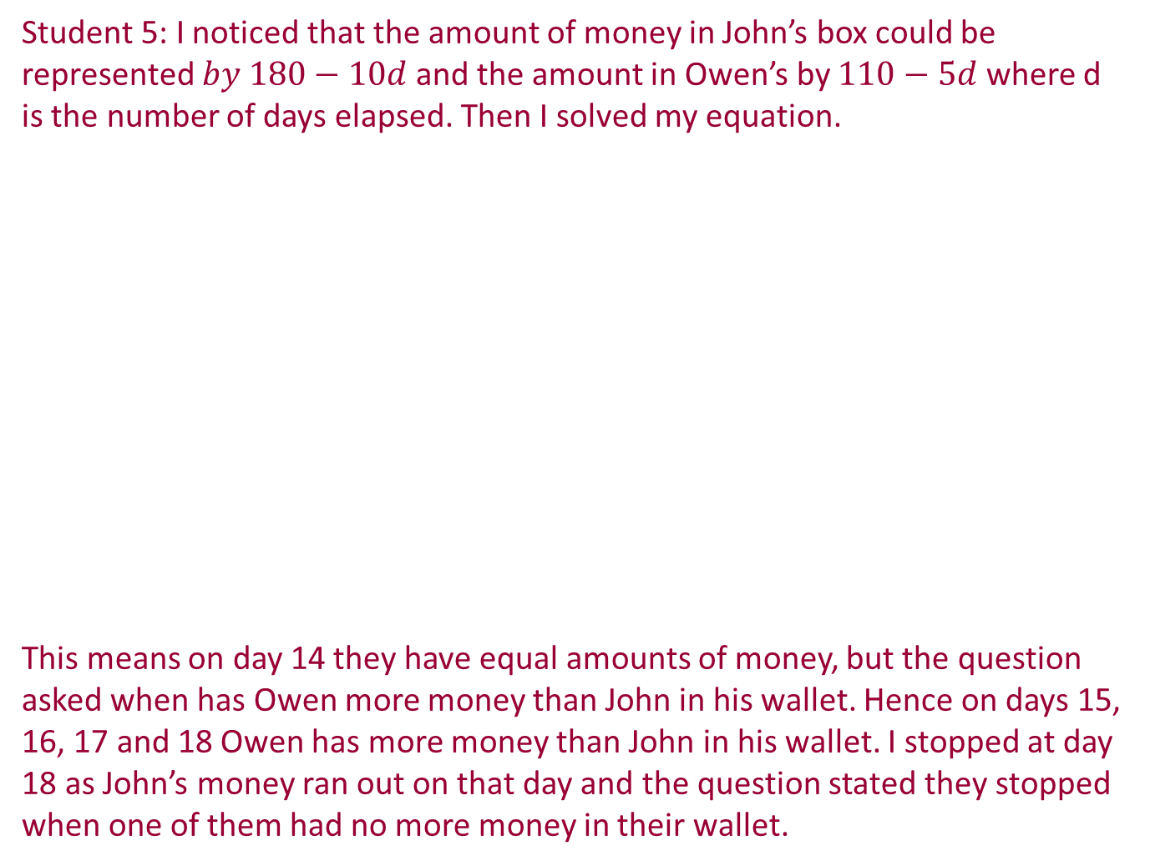
Student 5: I noticed that the amount of money in John’s box could be represented $by 180−10d$and the amount in Owen’s by $110−5d$ where d is the number of days elapsed. Then I solved my equation.
This means on day 14 they have equal amounts of money, but the question asked when has Owen more money than John in his wallet. Hence on days 15, 16, 17 and 18 Owen has more money than John in his wallet. I stopped at day 18 as John’s money ran out on that day and the question stated they stopped when one of them had no more money in their wallet.
$$Owen=John$$
Lesson interaction
$$110 −5 d=180 −10 d$$
$$+10 d$$
$$+10 d$$
$$110+5 d=180$$
$$−110$$
$$−110$$
$$5 d=70$$
$$÷5$$
$$÷5$$
$$d=14$$

Slide 40
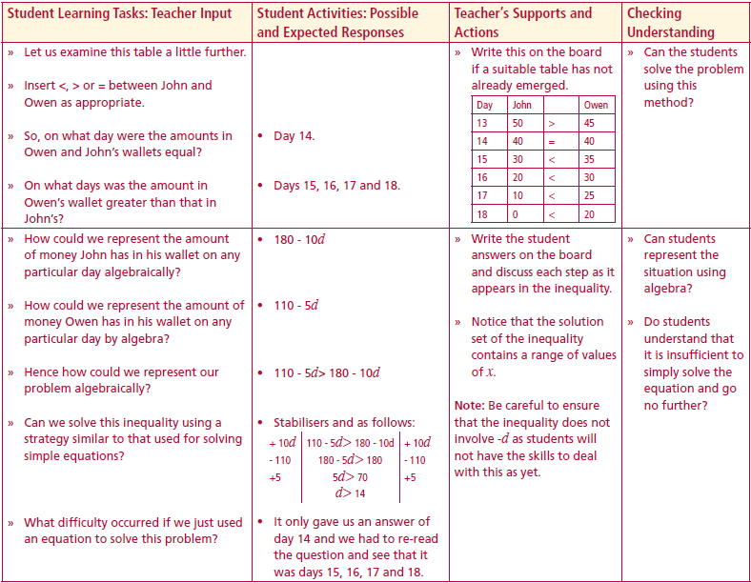
Let us examine this table a little further.
Insert <, > or = between John and Owen as appropriate.
So, on what day were the amounts in Owen and John’s wallets equal?
On what days was the amount in Owen’s wallet greater than that in John’s?
Hence on days 15, 16, 17 and 18 Owen has more money than John in his wallet
John Owen
$$x$$ | 180 - 10x |  | 110 - 5x
13 | 180 - 10 (13)$=$ 50 |  | 110 - 5 (13)$=$ 45
14 | 180 - 10 (14)$=$ 40 |  | 110 - 5 (14)$=$ 40
15 | 180 - 10 (15)$=$ 30 |  | 110 - 5 (15)$=$ 35
16 | 180 - 10 (16)$=$ 20 |  | 110 - 5 (16)$=$ 30
17 | 180 - 10 (17)$=$ 10 |  | 110 - 5 (17)$=$ 25
18 | 180 - 10 (18)$=$ 0 |  | 110 - 5 (18)$=$ 20
19
Lesson interaction
$$>$$
$$=$$
$$<$$
$$<$$
$$<$$
$$<$$
$$Not possible$$

Slide 41
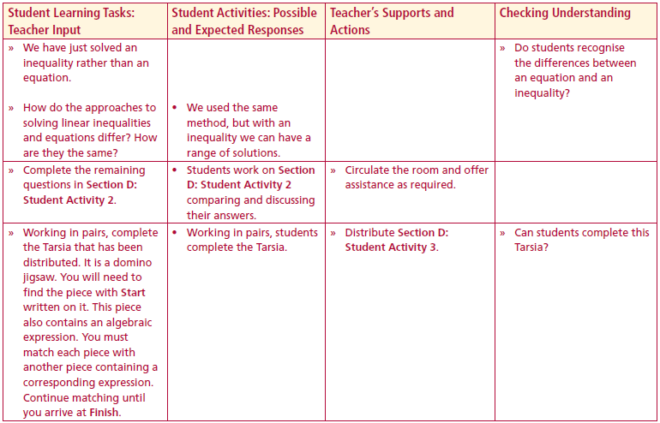
How could we represent the amount of money John has in his wallet on any particular day algebraically?
How could we represent the amount of money Owen has in his wallet on any particular day by algebra?
Hence how could we represent our problem algebraically?
Can we solve this inequality using a strategy similar to that used for solving simple equations?
What difficulty occurred if we just used an equation to solve this problem?
We have just solved an inequality rather than an equation.
How do the approaches to solving linear inequalities and equations differ? How are they the same?
Complete the remaining questions in Section D: Student Activity 2
$$180 −10 d$$
$$110 −5 d$$
Lesson interaction
$$Owen>John$$
$$+10 d$$
$$110 −5 d>180 −10 d$$
$$+10 d$$
Lesson interaction
$$−110$$
$$110+5 d>180$$
$$−110$$
$$÷5$$
$$5 d>70$$
$$÷5$$
$$d>14$$

Slide 42
Section D: Student Activity 2 Solving inequalities of the form $ax + b < cx + d.$
2. Declan is having a party and is buying pizzas and chips. He has at most €20 to spend on food and his budget for chips is exactly €4.60. What is the maximum number of pizzas he can buy, if each pizza costs €3.50? The shop only sells whole pizzas.
3. John and Michael go running in order to keep fit. John runs each day from Monday to Friday and then runs 2 kilometres each Saturday.
Michael goes running on Mondays, Tuesdays and Wednesdays and also runs 9 kilometres each Sunday.
They each run the same fixed distance on the weekdays on which they run.
John runs further each week than Michael. Write an inequality to represent this situation.
Investigate what is the minimum number of kilometres for which this inequality is true using a table, graph and algebra.

Slide 43
Section D: Student Activity 2 Solving inequalities of the form $ax + b < cx + d.$
4. When on holiday in France for a week, Emma’s dad hired a car. He paid a fixed rental of €200 per week and €0.15 per kilometre for each journey undertaken. He has at most €300 to spend on car hire. What is the maximum number of kilometres he can drive in the hired car?
5. The length of Lisa's rectangular dining room is 4 metres. If the area of the room is at least 12 square metres, what is the smallest width the room could have?
6. Tell the story of possible shopping trips that could be represented by the following inequalities:
i. $3x + 7 < 40$
ii. $5x + 30 > 50$

Slide 44
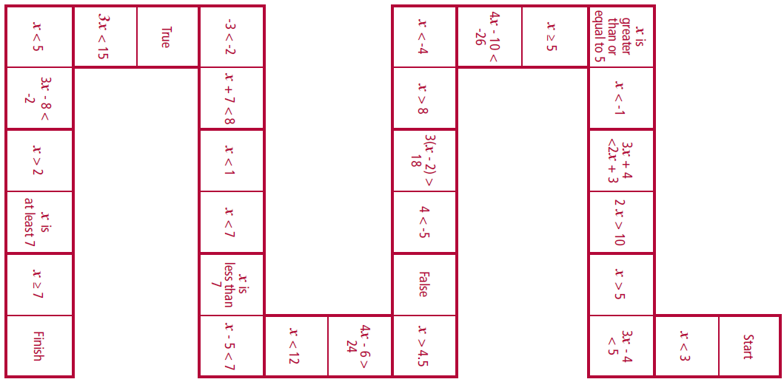
Section D: Student Activity 3 Tarsia

Slide 45
Section D: Student Activity 3 Tarsia
Lesson interaction

Slide 46
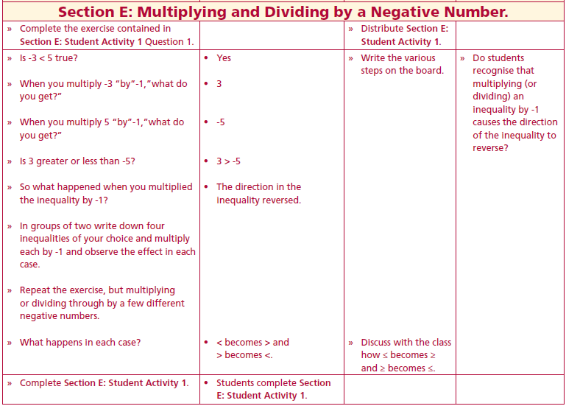
Section E: Student Activity 1 Multiplying and Dividing an inequality by a Negative Number.
1a. Circle the numbers - 3 and 5 on the number line below.
b. Which of these two numbers is smaller? Explain your answer referring to the number line.
c. Insert the correct symbol (<, >, ≤, ≥) into the box -3 5.
d. By multiplying the -3 and the 5 by -1 fill in the boxes below and represent the answer on the number line in part a.
-3 multiplied by -1 = 5 multiplied by -1 =
e. Which of the numbers from part d. is the smaller?
Explain your answer referring to the number line.
Lesson interaction

Slide 47
Section E: Student Activity 1 Multiplying and Dividing an inequality by a Negative Number.
Is -3 < 5 true?
When you multiply -3 “by”-1,”what do you get?”
When you multiply 5 “by”-1,”what do you get?”
Is 3 greater or less than -5?
So what happened when you multiplied the inequality by -1?
In groups of two write down four inequalities of your choice and multiply each by -1 and observe the effect in each case.
Repeat the exercise, but multiplying or dividing through by a few different negative numbers.
What happens in each case?
Lesson interaction

Slide 48
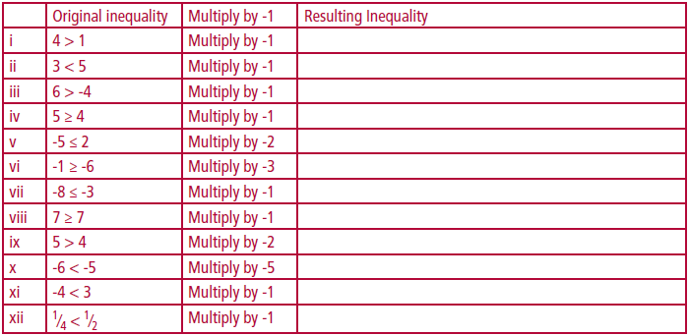
Section E: Student Activity 1 Multiplying and Dividing an inequality by a Negative Number.
2.
3. From your experience of the exercise above, can you conclude what happens to an inequality when you multiply both sides by -1?
4. What conclusion do you arrive at when you multiply both sides of an inequality by the same negative number?

Slide 49
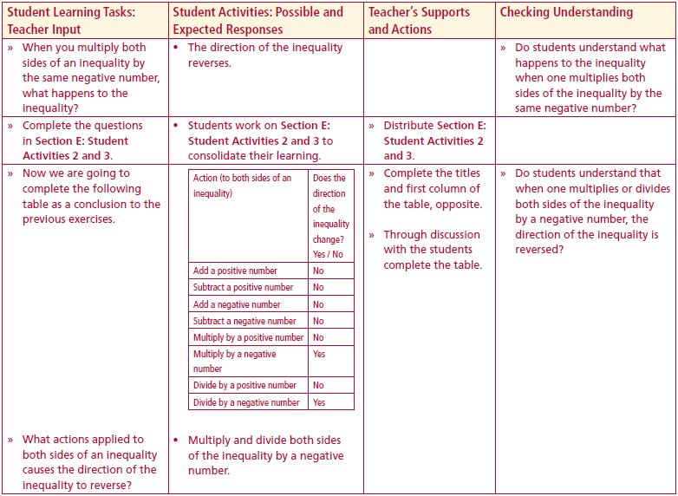
Section E: Student Activity 2 Multiplying and Dividing an inequality by a Negative Number.
Perform the action contained in the arrow to each side of the given inequality in the centre. In which of the new inequalities did the direction of the inequality differ from the original inequality?
Lesson interaction
$$6<12$$
$$0<6$$
$1<$3
Add 3
Subtract 3
Divide by 3
$$−1>−2$$
Divide by -3
$$3<9$$
Subtract -3
$$6<12$$
Multiply by -3
Multiply by 3
Add -3
$$−9>−27$$
$$9<27$$
$$0<6$$

Slide 50
Section E: Student Activity 3 Multiplying and Dividing an inequality by a Negative Number.
1a)
b If you add the same positive number to each side of the inequality do you reverse the direction of the inequality? Give examples. ___________________ ________________________________________________________________________________________________________________________________

Slide 51
Section E: Student Activity 3 Multiplying and Dividing an inequality by a Negative Number.
2a)
b If you add the same negative number to each side of the inequality do you reverse the direction of the inequality? Give examples. ___________________ ________________________________________________________________________________________________________________________________

Slide 52
Section E: Student Activity 3 Multiplying and Dividing an inequality by a Negative Number.
3a)
b If you subtract the same positive number from each side of the inequality do you reverse the direction of the inequality? Give examples. ________________ ________________________________________________________________________________________________________________________________

Slide 53
Section E: Student Activity 3 Multiplying and Dividing an inequality by a Negative Number.
4a)
b If you subtract the same negative number from each side of the inequality do you reverse the direction of the inequality? Give examples. ________________
________________________________________________________________________________________________________________________________

Slide 54
Section E: Student Activity 3 Multiplying and Dividing an inequality by a Negative Number.
5a)
b If you multiply each side of an inequality by the same positive number do you reverse the direction of the inequality? ____________________________ ________________________________________________________________________________________________________________________________

Slide 55
Section E: Student Activity 3 Multiplying and Dividing an inequality by a Negative Number.
6a)
b If you multiply each side of an inequality by the same negative number do you reverse the direction of the inequality? ____________________________ ________________________________________________________________________________________________________________________________

Slide 56
Section E: Student Activity 3 Multiplying and Dividing an inequality by a Negative Number.
7a)
b If you divide each side of an inequality by the same positive number do you reverse the direction of the inequality? Give examples. ___________________ ________________________________________________________________________________________________________________________________

Slide 57
Section E: Student Activity 3 Multiplying and Dividing an inequality by a Negative Number.
8a)
b If you divide each side of an inequality by the same negative number do you reverse the direction of the inequality? ? Give examples. _________________ ________________________________________________________________________________________________________________________________

Slide 58
Section F: Student Activity 1 To solve inequalities of the form $−ax + b < c.$
Now we are going to complete the following table as a conclusion to the previous exercises
What actions applied to both sides of an inequality causes the direction of the inequality to reverse?
Action (to both sides of an inequality) | Does the direction of the inequality change? Yes / No
Add a positive number
Subtract a positive number
Add a negative number
Subtract a negative number
Multiply by a positive number
Multiply by a negative number
Divide by a positive number
Divide by a negative number Yes
Yes

Slide 59
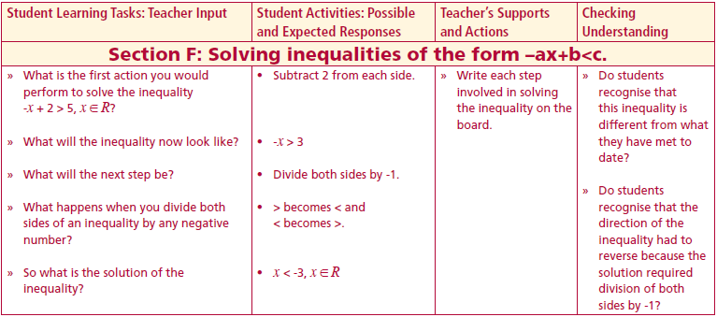
Section F: Student Activity 1 To solve inequalities of the form $−ax + b < c.$
What is the first action you would perform to solve the inequality $−x + 2 > 5, x ∈ R?$
What will the inequality now look like?
What will the next step be?
What happens when you divide both sides of an inequality by any negative number?
So what is the solution of the inequality?
$$−x + 2 > 5$$
$$−2$$
$$−2$$
Lesson interaction
$$−x >3$$
$$÷(−1)$$
$$÷(−1)$$
$$x<−3$$

Slide 60
Section F: Student Activity 1 To solve inequalities of the form $−ax + b < c.$
1 Solve the following inequalities where x ∈ R:
$−x + 2 > 5$
ii. $−x + 2 > −5$
iii. $−x −6 < 5$
iv. $−2x + 3 < 5$
v$. −2x + 3 < 27$
vi. $−12x + 3 ≥ 111$
vii. $4 − 3x ≥ 46$
viii. $−2x + 3 ≥ 10$
ix. $−3x + 3 ≥ 17$

Slide 61
Section F: Student Activity 1 To solve inequalities of the form $−ax + b < c.$
2 Fiona has €500 in her bank account. The only payment she makes from this account is to cover her mobile phone bill of €40 per month. This money is paid from the bank account at the end of each month. The bank stated they will warn her when the account goes below €25. Write an inequality to represent this problem and solve the inequality. _________________________________ ________________________________________________________________________________________________________________________________________________________________________________________________________________________________________________________________________________________________________________________________

Slide 62
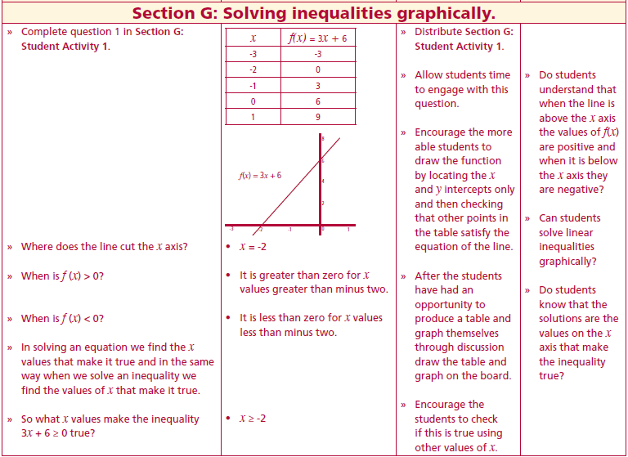
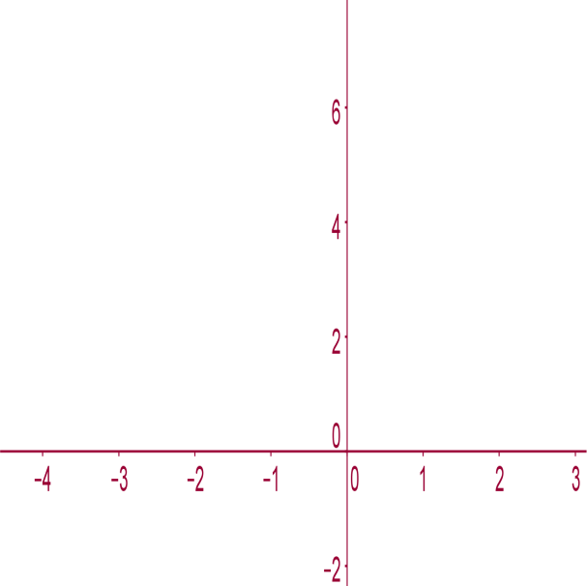
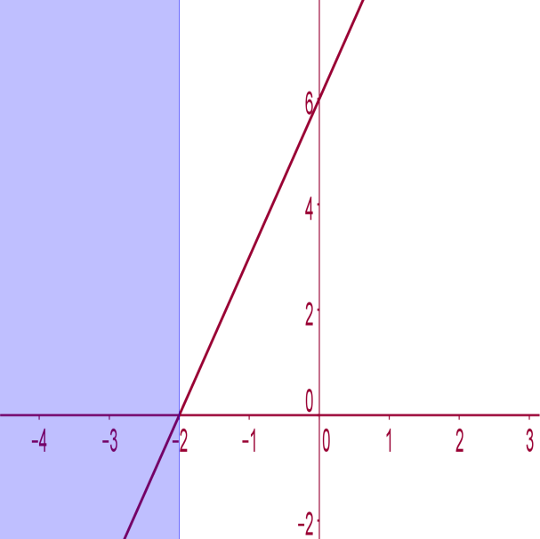
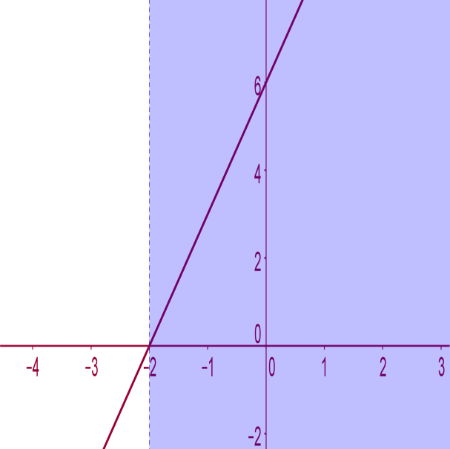
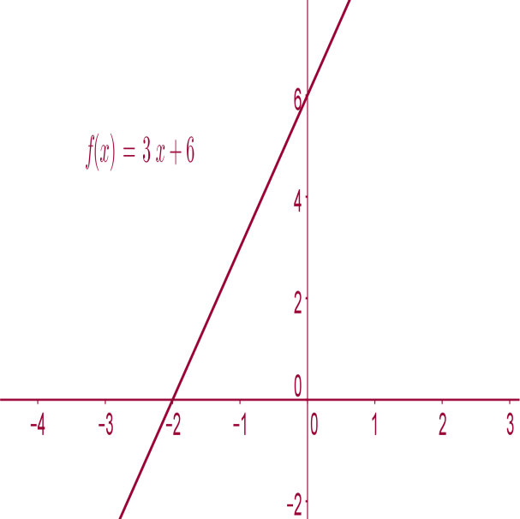
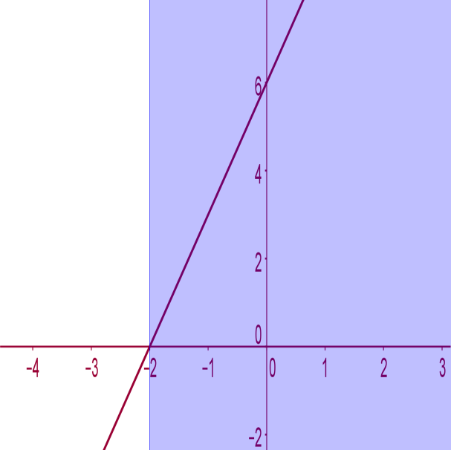
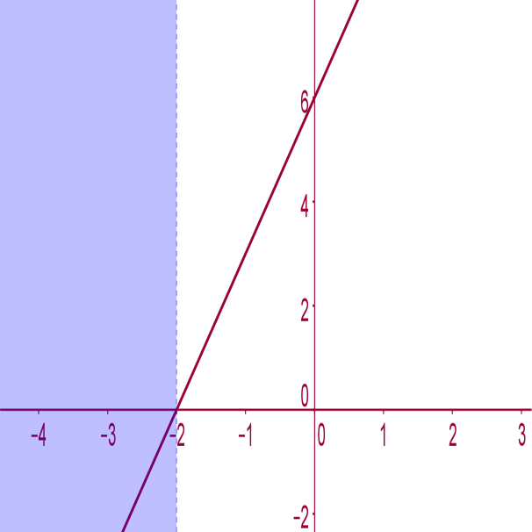
Section G: Student Activity 1 Solving inequalities graphically.
Complete a table and draw the graph of the function $f(x) = 3x + 6, x ∈ R$, in the domain $−3 ≤ x ≤ 1$and graphically determine the solution set to each of the following inequalities:
Lesson interaction
$$x$$ | $$f(x) = 3x + 6$$
-3
-2
-1
0
1
$$x$$ | $$f(x) = 3x + 6$$
-3 | -3
-2 | 0
-1 | 3
0 | 6
1 | 9
Where does the line cut the x axis?
When is $f (x) > 0$?
When is $f (x) < 0$?
In solving an equation we find the x values that make it true and in the same way when we solve an inequality we find the values of x that make it true.
So what x values make the following inequalities true
i. $3x + 6 ≥ 0$
ii. $3x + 6 ≤ 0$
iii. $3x + 6> 0$
iv. $3x + 6 < 0.$
$$3x + 6> 0$$
$$f(x) = 3x + 6$$
$$3x + 6 ≤ 0$$
$$3x + 6 < 0$$
$$3x + 6 ≥ 0$$

Slide 63
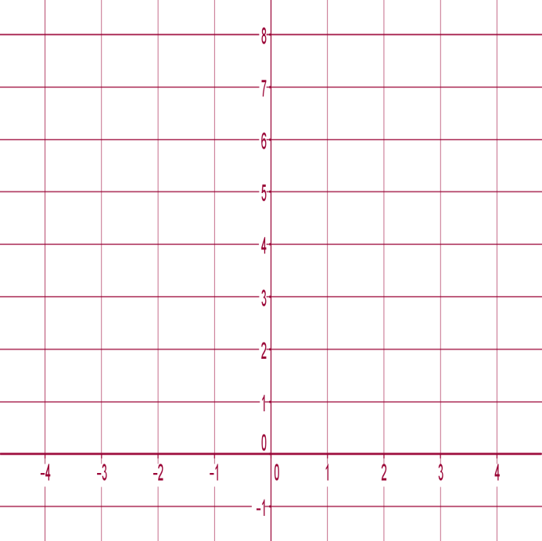
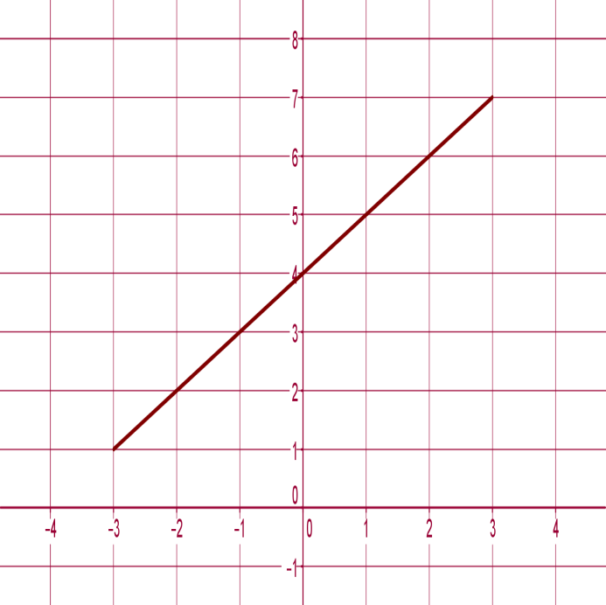
Section G: Student Activity 1 Solving inequalities graphically.
2. Complete a table and draw the graph of the function $f(x) = x + 4, x ∈ R$, in the domain $−3 ≤ x ≤ 3$and graphically determine solution set to each of the following inequalities:
i. $x + 4 ≥ 0$
ii. $x + 4 ≤ 0$
iii. $x + 4 > 0$
iv. $x + 4 < 0.$
$$f(x) = x +4$$

Slide 64
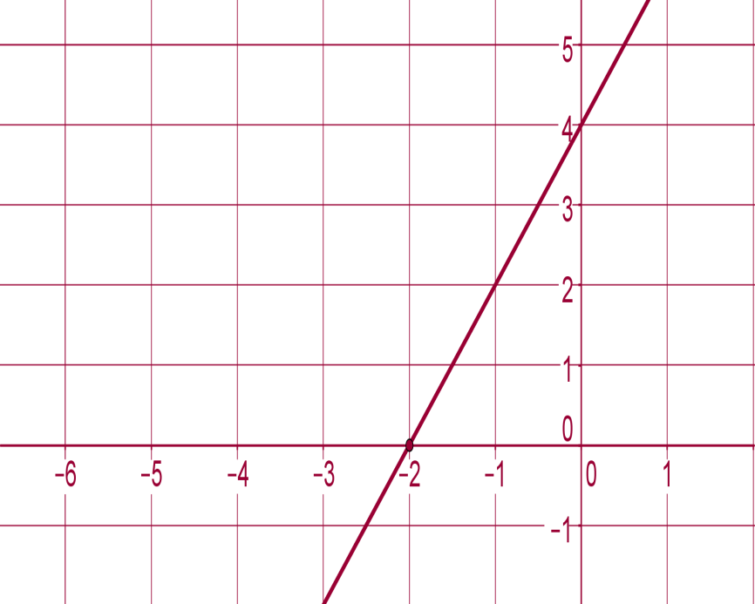
Section G: Student Activity 1 Solving inequalities graphically.
3. Plot the function $f(x) = 2x + 5$and the function $g(x) = 5$where $x ∈ R$on the same axes and scale. Find the point of intersection of the two graphs and hence find the solution set of $2x + 3 ≥ 5.$
4. Draw the function $f(x) = x + 4$and the function $g(x) = 2x + 1$where $x ∈ R$on the same graph. By examining the graph determine which values of x satisfy the inequality $2x + 1 < x + 4.$
5. Find the equation of the line represented in the diagram below and hence find an inequality of the form $ax + b < k$, whose solution is represented by the arrow on the x axis.

Slide 65
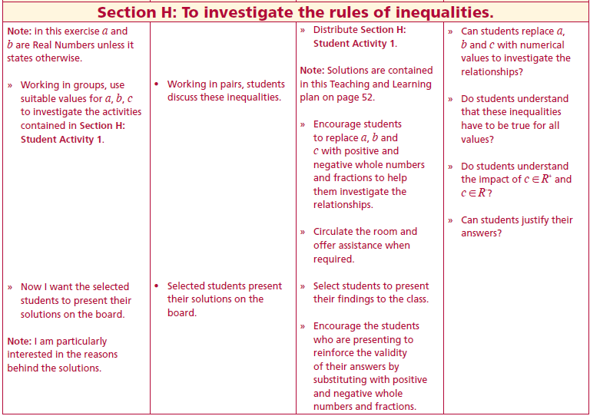
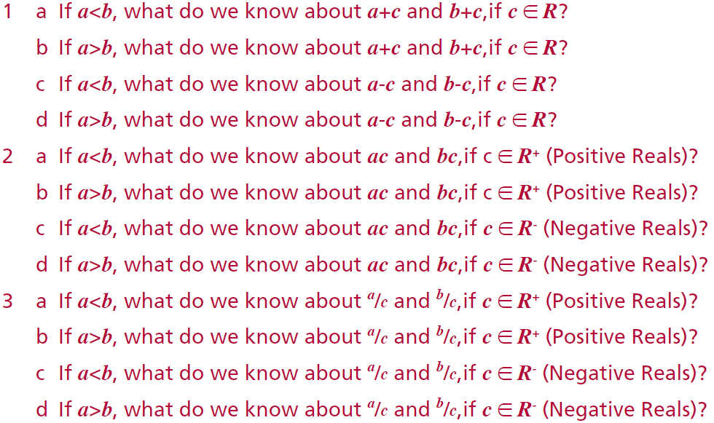
Section H: Student Activity 1 To investigate the rules of inequalities.
Note in this exercise a and b are Real numbers unless it states otherwise.
1a If $a<b$ $a+c<b+c$ If $c∈R$
b If $a>b$ $a+c>b+c$ If $c∈R$
c If $a<b$ $a−c<b−c$ If $c∈R$
d If $a>b$ $a−c>b−c$ If $c∈R$
2a If $a<b$ $ac<bc$ If $c∈R^{+}$
b If $a>b$ $ac>bc$ If $c∈R^{+}$
c If $a<b$ $ac>bc$ If $c∈R^{−}$
d If $a>b$ $ac<bc$ If $c∈R^{−}$
3a If $a<b$ $a/c<b/c$ If $c∈R^{+}$
b If $a>b$ $a/c>b/c$ If $c∈R^{+}$
c If $a<b$ $a/c>b/c$ If $c∈R^{−}$
d If $a>b$ $a/c<b/c$ If $c∈R^{−}$
Lesson interaction
Sol Q1
Sol Q2
Sol Q3

Slide 66
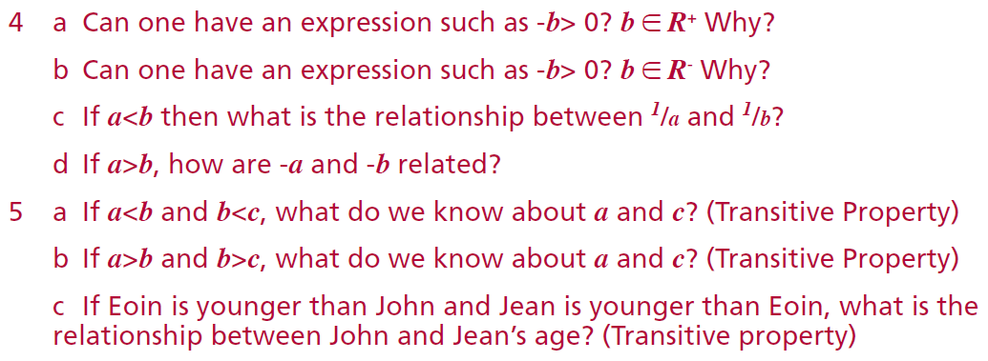
Section H: Student Activity 1 To investigate the rules of inequalities.
Note in this exercise a and b are Real numbers unless it states otherwise.
5a If $a<b$ and $b<c$ $a<c$
b If $a>b$ and $b>c$ $a>c$
c If $Eoin<John$ and $Jean<Eoin$ then $Jean>John$
4a No as –(b) < 0 If $b∈R^{+}$ e.g –(5) < 0
b Yes as –(b) > 0 If $b∈R^{−}$ e.g –(–5) > 0
c If $a<b$ $1/a>1/b$
d If $a>b$ $−a<−b$
Sol Q4
Sol Q5

Slide 67
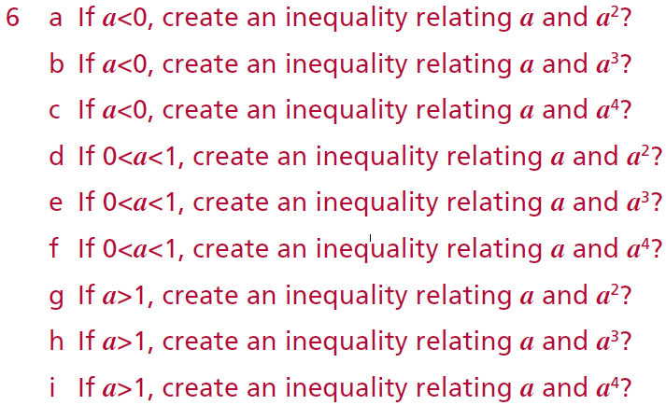
Section H: Student Activity 1 To investigate the rules of inequalities.
Note in this exercise a and b are Real numbers unless it states otherwise.
6a If $a<0$ then $a<a^{2}$
b If $a<0$ then $a>a^{3}$
c If $a<0$ then $a<a^{4}$
d If $0<a<1$ then $a>a^{2}$
e If $0<a<1$ then $a>a^{3}$
f If $0<a<1$ then $a>a^{4}$
g If $a>1$ then $a>a^{2}$
h If $a>1$ then $a<a^{3}$
i If $a>1$ then $a>a^{4}$
Sol Q6

Slide 68
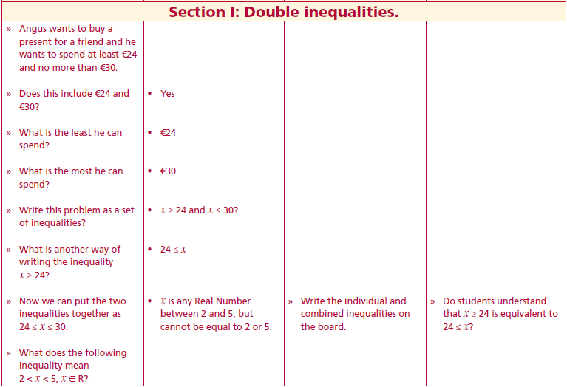
Section I: Student Activity 1 Double Inequalities .
Angus wants to buy a present for a friend and he wants to spend at least €24 and no more than €30.
Does this include €24 and €30?
What is the least he can spend?
What is the most he can spend?
Write this problem as a set of inequalities?
What is another way of writing the inequality x ≥ 24?
Now we can put the two inequalities together as 24 ≤ x ≤ 30.
Lesson interaction

Slide 69
Section I: Student Activity 1 Double Inequalities .
What does the following inequality mean $2 < x < 5, x ∈ R$?
How could we represent $−2 < x < 5, x ∈ R$on the number line?
Why did you use open circles at -2 and at 5?
If the inequality had been $−2 ≤ x ≤ 5, x ∈ R$ instead of <, how would this affect the representation of the inequality on the number line?
If the inequality had been $−2 < x < 5, x ∈ Z$, what effect would this have had?
Do the exercises 1-5 contained in Section I: Student Activity 1.
Lesson interaction
Lesson interaction

Slide 70
Section I: Student Activity 1 Double Inequalities .
1.(Revision)
a Represent $x ≤ 6, x ∈ R$on the number line.
b Represent $x ≥ 2, x ∈ R$on the number line.
c Represent the intersection of the above two inequalities above on the number
line.
d Rewrite the inequality $x≥ 2$in the format $a ≤ x.$
e Now write the intersection of the two inequalities in the format $a ≤ x ≤ b.$

Slide 71
Section I: Student Activity 1 Double Inequalities .
2 Maureen takes between two and three hours to do her homework. Write this
as an inequality.
3 A sweet company produces bags of sweets that will contain between 18 and
22 sweets. If there are less than 18 sweets or more than 22 sweets in a bag
then their machine is faulty. Write an inequality to represent the number of
sweets in an acceptable bag of sweets.
4 A farmer says the minimum number of cows he can keep on his farm is 22 and
the maximum is 35, write this as an inequality.

Slide 72
Section I: Student Activity 1
5 Represent the following on the number lines provided
a $1 ≤ x ≤ 4, x ∈ N$
b $−3 ≤ x ≤ 4, x ∈ Z$
c $−3 ≤ x ≤ 4, x ∈ R$
d $−3 < x ≤ 4, x ∈ Z$
e $−3 < x < 4, x ∈ Z$
f $−3 < x < 4, x ∈ R$
g $−3 ≤ x < 4, x ∈ R$

Slide 73
Section I: Student Activity 1
How would one solve the inequality
Now write this inequality as two inequalities.
Can any of these inequalities be simplified?
Now draw this on the number line.
So what is another way of writing the solution?
Complete the remaining exercises in Section I: Student Activity 1.
$$3 ≤ − 2x + 1 ≤ 7, x ∈ R?$$
$$−1$$
$$2≤−2x≤6$$
$$−1$$
Lesson interaction
$$÷2$$
$$1≤−x≤3$$
$$÷2$$
$$÷(−1)$$
$$−1≥x≥−3$$
$$÷(−1)$$
$$−1≥x \& x≥−3$$
$$x≤−1 \& x≥−3$$
$$−3≤x≤−1$$

Slide 74
Section I: Student Activity 1
6 Solve the following inequalities and represent the solution set on the number
lines:
a $−3 < x + 2 < 5, x ∈ R$
b $−3 ≤ x + 2 ≤ 5, x ∈ Z$
c $−2 ≤ x + 3 ≤ 5, x ∈ R$
d $−2 < x + 3 < 4, x ∈ Z$
e $−2 ≤ x − 1 ≤ 4, x ∈ R$

Slide 75
Section I: Student Activity 1
7 Solve the following inequalities and represent the solution set on the number line:
a $−1 ≤ 2x + 3 ≤ 7, x ∈ R$
B $−3 ≤2x + 4 ≤ 3, x ∈ R$
C $4 < 2x + 1 < 5, x ∈ R$
d $4 < 2x + 1 < 5, x ∈ Z$
e $4 < 2x + 1 < 5, x ∈ N$
f $3 < − 2x + 1 < 5, x ∈ R$

Slide 76
Section I: Student Activity 1 Double Inequalities.
8 The temperature in a certain town ranged between 18°C and 22°C on a particular day. Represent this as an inequality in the form a < t < b, where t represents temperature.
9 Ryan wants to spend between €45 and €67 on a present. If €a is the amount he wishes to spend, represent his situation as an inequality.
10 The number of matches in a box is between 95 and 103. Represent this statement as an inequality.
11 Brendan has €x and we know that if he had 3 less it, he would have between €2 and €10. Represent this as an inequality and solve it.
12 A student wants to keep the cost of his phone calls per week between €5 and €7 per week. Calls cost €0.20 per call. Write an inequality to represent this and solve the inequality to determine the maximum number of calls this student can make while remaining within his budget.

Slide 77
Section I: Student Activity 1 Double Inequalities.
13 A household wants to keep its electricity charges between €30 and €35 per week. Assuming that there is a standing charge of €5 per week and each unit of electricity costs €0.10 per unit. Write an inequality to represent the range of units that this family can use per week.
14 The average number of sweets in a box of a particular brand of sweets is
150, but the number can vary by ±5. Write an inequality to represent the number of sweets in the box.
15 A dog food company has a tolerance level of 0.8 Kg on an 8Kg bag of dog food. Write an inequality that represents an acceptable weight for a bag of this dog food.
16 Solve $2 (x + 3) > x + 3$.
17 Solve $−8 < −3x + 1 < 4, x ∈ R$and show the solution on the number line.
18 Solve $11 < −4x + 3 < 15, x ∈ R$and show the solution on the number line.

Slide 78
Section I: Student Activity 2 Tarsia

Slide 79
Section I: Student Activity 3 Graph Matching
Graph Matching Exercise.
These need to be laminated and cut into separate pieces before the class. Students will then be asked to match them. Note every Important Word does not have an Equivalent Form to match with.

